Slide 1
Introduction to RTX Kernel
Semaphore

Slide 2
Semaphore
os_sem_init ----Initializes a semaphore object.
os_sem_send ----Sends a signal (token) to the semaphore.
os_sem_wait---- Waits for a signal (token) from the semaphore.
RTOS LAB

Slide 3
OS_SEM
Create a semaphore object of type OS_SEM.
Syntax
OS_SEM semaphore1;
RTOS LAB

Slide 4
os_sem_init
This function initializes the semaphore object identified by the function argument.
Syntax
void
os_sem_init
(
OS_ID semaphore,
token_count
);
RTOS LAB

Slide 5
os_sem_send
The os_sem_send function increments the number of tokens in the semaphore object identified by the function argument.
Syntax
os_sem_send
);
OS_RESULT
(
OS_ID semaphore
RTOS LAB

Slide 6
os_sem_wait
The os_sem_wait function requests a token from the semaphore identified by the function argument.
Syntax
OS_RESULT
os_sem_wait
(
OS_ID semaphore,
timeout
);
RTOS LAB

Slide 7
Shared Resource Access Synchronization
TASK 1
B
DISPLAY
(UART)
TASK 2
RTOS LAB

Slide 8
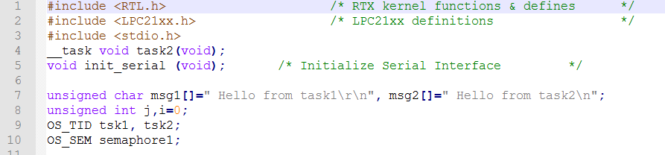
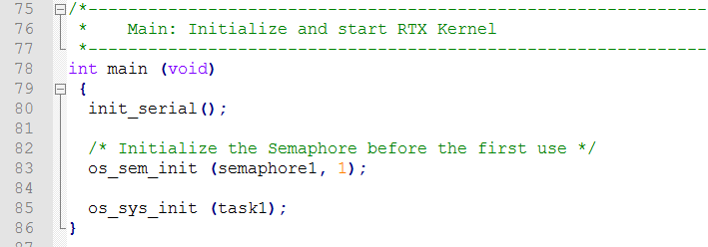

RTOS LAB

Slide 9
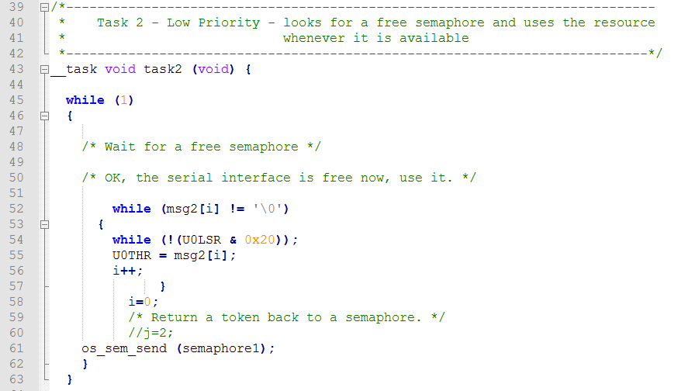
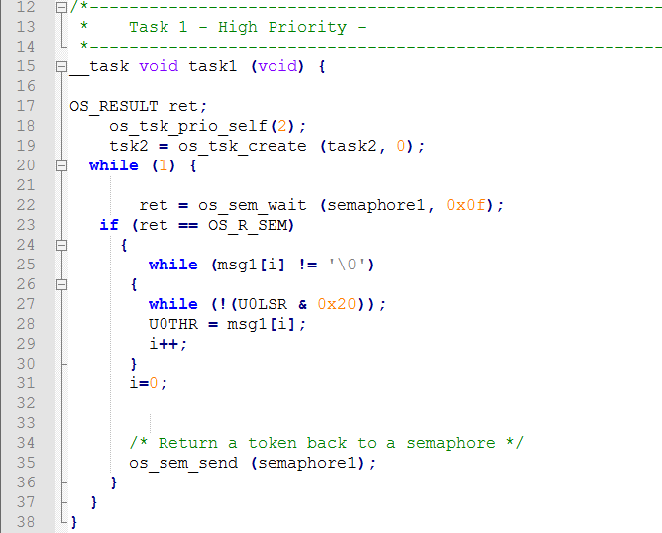
RTOS LAB

Slide 10
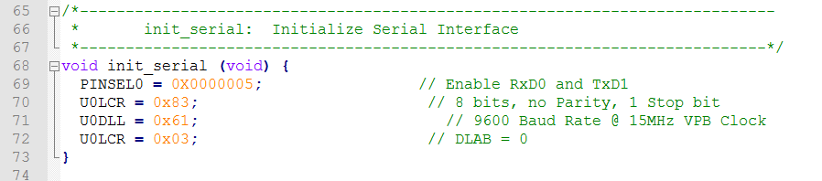
RTOS LAB

Slide 11
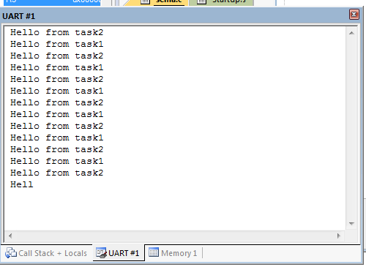
Results
RTOS LAB

Slide 12
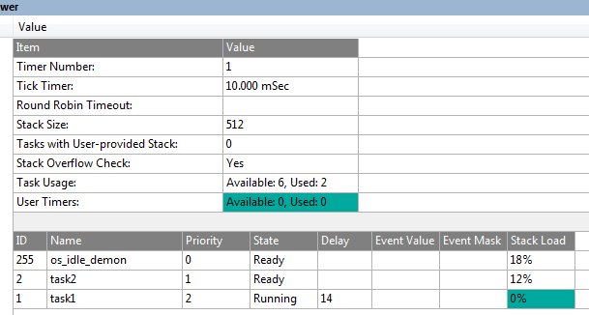
Results
RTOS LAB

Slide 13
Thank you
RTOS LAB

